Slide 1

Download at:
github.com/zbelateche/mafia_gamee

Slide 2
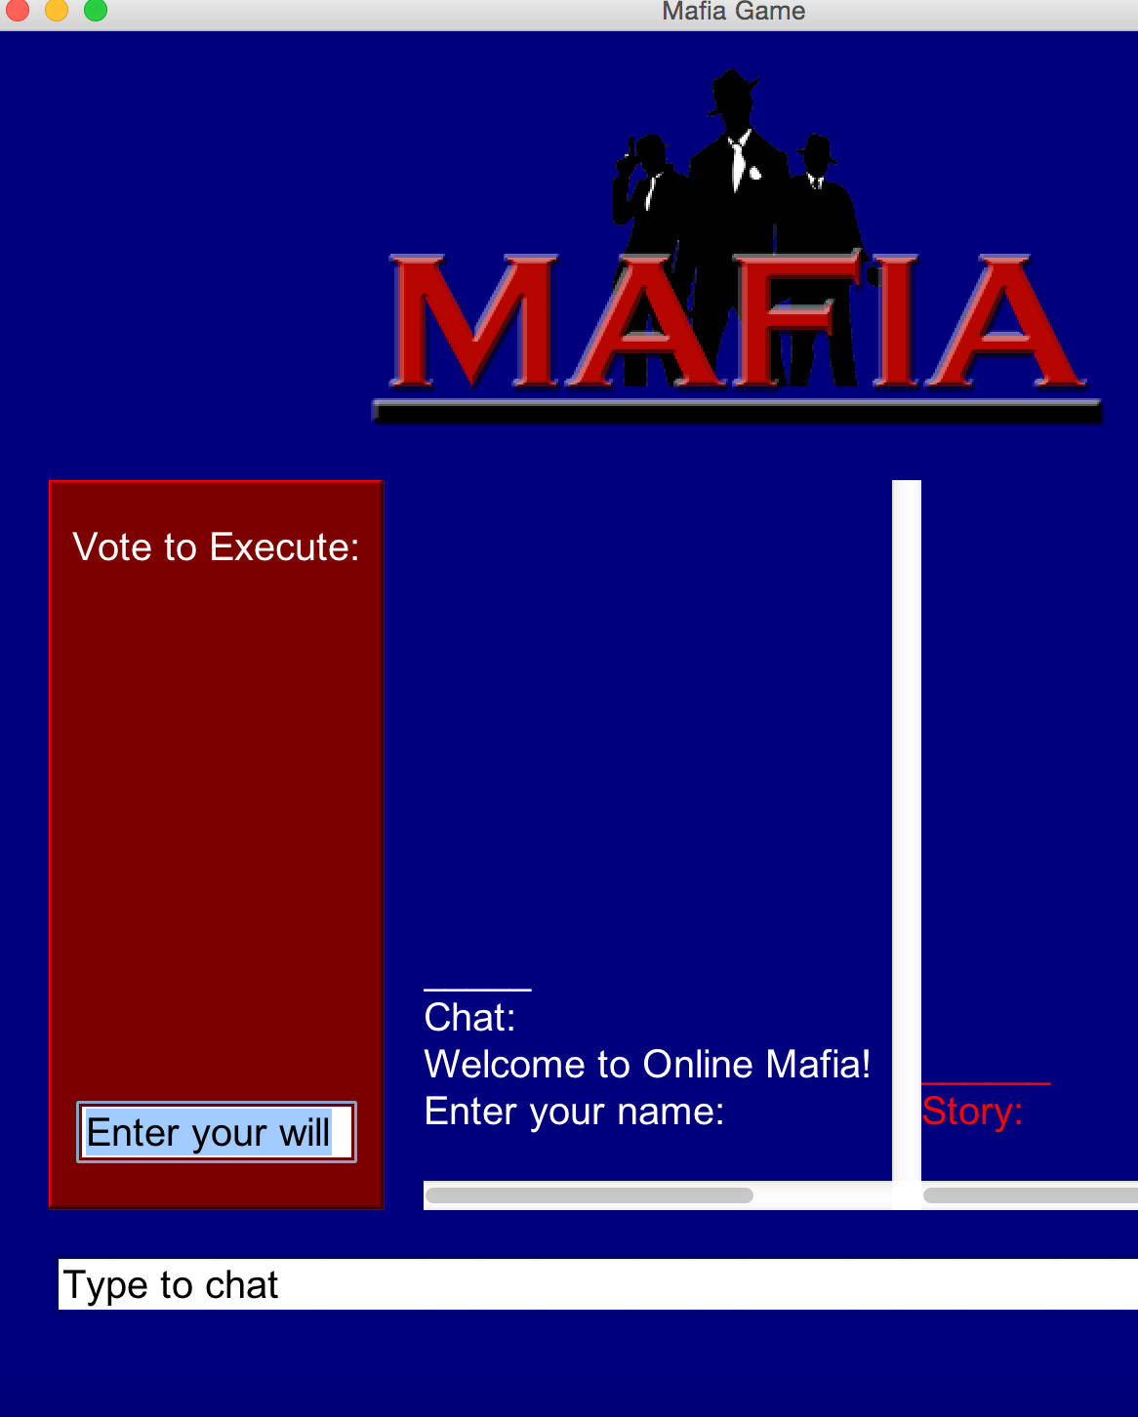
Enter your name please:
Problems that could occur:
Two people have the same name
A person’s name has a space

Slide 3
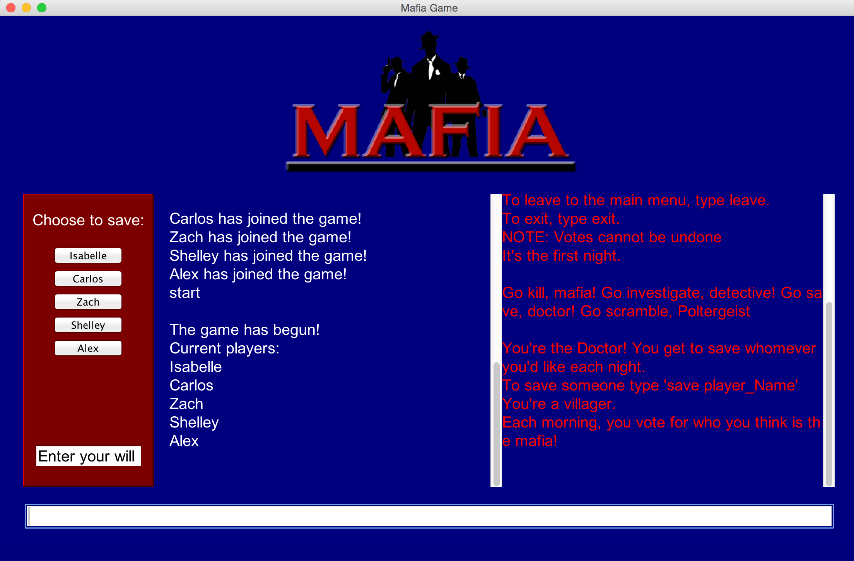
Two people have the same name….

Slide 4
How we dealt with it:
Our Code
if ( this.getName().toLowerCase().equals(a.getName().toLowerCase() ) )
{
this.out.println( “Somebody already has that name. We'll call you ” + this.getName()+ “2.” );
this.name = this.getName() + “2”;
}
Before
After
Players
Alex
Shelley
Carlos
Alex
Isabelle
Line 1
alex.equals(shelley)? X
alex.equals(carlos)? X
alex.equals(alex)? **
name = Alex +2
Players
Alex2
Shelley
Carlos
Alex
Isabelle

Slide 5
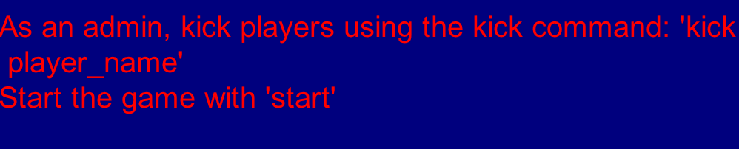
A person enters a name with a space in it…
kick Shelley Jain
Players
Alex2
Shelley Jain
Carlos
Alex
Isabelle
Where’s Shelley :(

Slide 6
How we dealt with it:
Our Code
if( this.getName().indexOf(‘ ’)>-1 )
{
this.name=this.getName().substring(0,this.getName().indexOf(‘ ’));
this.out.println(“No spaces in names. We're shortening your name to ”+this.getName()+ “.”);
}
//if there is a space
the index of the space
name=
name.substring(0,7)
= “Shelley”
0 | 1 | 2 | 3 | 4 | 5 | 6 | 7 | 8 | 9 | 10 | 11
Methods to note:
index of
substring
Enter Name: S h e l l e y J a i n
-1
name.indexOf(‘e’)…[returns] 2
name.indexOf(‘z’)… [returns] -1

Slide 7
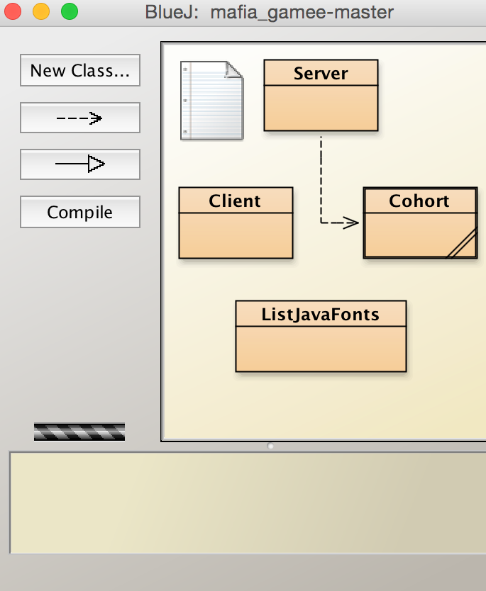
How it Works?
Server- Handles each individual user (thread) for inputs and outputs
Cohort (Games)- Handles the entire game by synchronizing events
Clients- Presents the interface where players can make choices

Slide 8
What’s special about ours?
New Character! Poltergeist!
Different way of assigning mafia
The Will

Slide 9

What we’re going to see?
Instance Variables and Constructors
Accessors and Mutators
While Loop
private String personName;
public Person(name){…}
public String getName() {…}
public void setName() {…}
not
while (personName != “Tara”) {
System.out.println(“You’re not Tara”)
}
INFINITE LOOP :(

Slide 10
Let’s write instance variables and a Constructor
Class name = Game
2 instance variables- the game’s name & the game’s password
constructor that takes 2 parameters - name and password
private String teamName;
private String pass;
public Game(String name, String password)
{
teamName = name;
pass = password;
}

Slide 11
While Loop
//checks if mafia<maxMafia
while(mafia < maxMafia) {
int target = (int)((Math.random()*teamMates.size()));
if( teamMates.get(target).isMafia() || teamMates.get(target).isDead() )
target = (int)((Math.random()*teamMates.size()));
else{
teamMates.get(target).makeMafia();
teamMates.get(target).out.println( "@You're a Mafia! You and your allies have to kill all the villagers to win." );
mafia++;
}
}
//target = random number between
0 to (number of players)
picks a random teammate
//if the random team mate is
already a mafia or dead
//target = new random number
//otherwise (i.e. if random teammate is not a mafia or dead)
//make random teammate a mafia
//increment number of mafia
Variables and Methods
mafia = current number of mafia
maxMafia = number of Players/4
isDead() = returns true if the player died
isMafia() = returns true if the player is a mafia
makeMafia() = makes a person a mafia
//int
//int
//accessor
//accessor
//mutator

Slide 12
While Loop
//checks if mafia<maxMafia
while(mafia < maxMafia) {
int target = (int)((Math.random()*teamMates.size()));
if( teamMates.get(target).isMafia() || teamMates.get(target).isDead() )
target = (int)((Math.random()*teamMates.size()));
else{
teamMates.get(target).makeMafia();
teamMates.get(target).out.println( "@You're a Mafia! You and your allies have to kill all the villagers to win." );
mafia++;
}
}
//target = random number between
0 to (number of players)
picks a random teammate
//if the random team mate is
already a mafia or dead
//target = new random number
//otherwise (i.e. if random teammate is not a mafia or dead)
//make random teammate a mafia
//increment number of mafia
Players
Evan
Shauna
Ari
Aubrey
Aileen
Eli
Isabelle
Darren
Example 2:
Mafia maxMafia
0 2
Players
Evan
Shauna
Ari
Aubrey
Aileen
Example 1:
Mafia maxMafia
0 1
*mafia*
/ 1
/ 2
/ 1
*mafia*
*mafia*

